Slide 1
Machine Learning in Healthcare
A Cancer prediction model using ML.

Slide 2
Lung Cancer Prediction Tool
Lung cancer is by far the leading cause of death by cancer among both men and women.
Prevention is always better than cure, if one sees the symptoms of lung cancer and knows the probability of them getting one, they can undertake measures to probably lead a more healthy lifestyle.
The program has three applications, the first one being a prediction tool for individuals to know the likelihood of the incidence of lung cancer, based on past data that has been collected keeping in mind various parameters.
1.

Slide 3
Insurance Companies
This program in it’s second application can also help insurance companies. It uses machine learning algorithms to predict the likelihood of an individual being affected by lung cancer and calculates the risk for the policy makers.
The program bifurcates the received output, from the ML algorithm into low risk or high risk profiles, which is based on the age and various other parameters of the individual.
2.

Slide 4
Medical Research
The third application of this tool is to provide a head start to individuals invested in medical research by providing them with options for treatment of cancer.
We’ve included two options in this program, which have various parameters and provide the user with a success rate of their plan of action for treatment based on the previous data fed to the Machine Learning algorithm.
3.

Slide 5
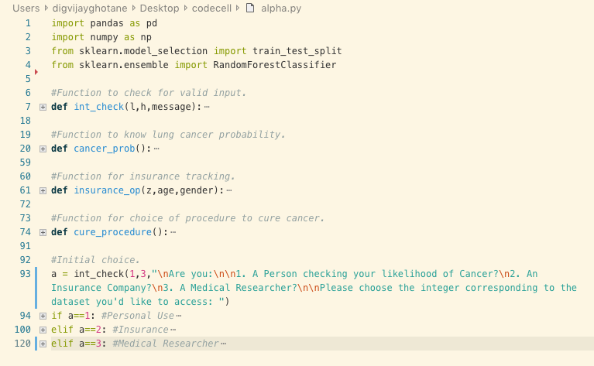
The Code

Slide 6
Labels & Features
Features
We’ve incorporated a total of 19 features in the program, across the four applications bundled inside it.
We’ve also made sure that every feature is accounted for in one or the other way for the machine learning process and predicting the most accurate label possible.
Labels
We have 2 labels in the algorithm. We’re trying to fulfill two different objectives in the project using machine learning, hence the variation.

Slide 7
Machine Learning Algorithm
The application of this particular model is based on Random Forest Classifiers.
This classifier got us the maximum output efficiency ranging between 85% to 94%, compared to other classifiers or regression models.
Instead of the conventional predictor, we used the probability predictor to get a probability factor.
This classifier is a part of the scikit-learn library which is one of the Machine Learning libraries used widely.
This Random Forest Classifier has decision trees and returns the highest voted upon condition. This is how it maximizes its efficiency.
The more the data the stronger the forest will be.

Slide 8
Data
Step 1:
The algorithm receives feedback from all and the highest vote that is received is taken into consideration for the prediction.
Output
Training Model
Test Model
Data Input
Step 2:
After the RFC Algorithm learns from the training model, it refines it’s learning algorithm using the divided test model from the universal dataset.
Step 3:
After the ML has completed learning, we can give a data input and receive a corresponding output that is based on previously incorporated data.
RFC Algorithm
Data Tree
Data Tree
Data Tree
Data Tree
Data Tree
Data Tree
Data Tree
Data Tree
Data Tree

Slide 9
Block Diagram
Start
Import Libraries
Define Functions
Train ML Algorithm
User Chooses Which Application
Lung Cancer Prediction Tool
Insurance Companies
Medical Research
Output
Output
Output

Slide 10
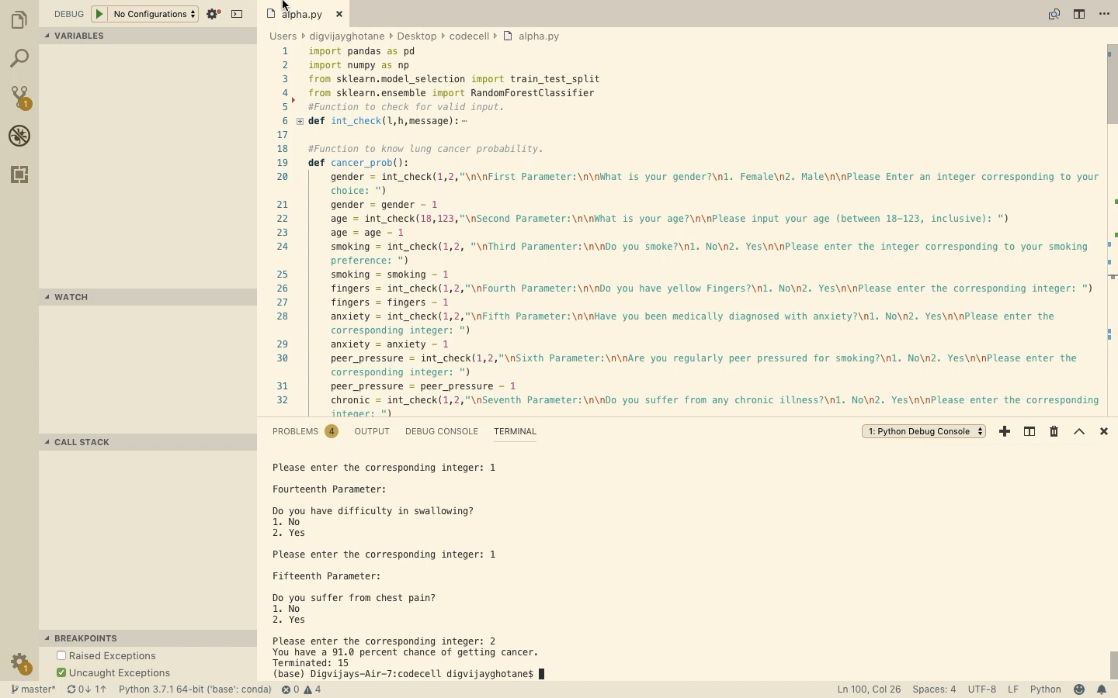
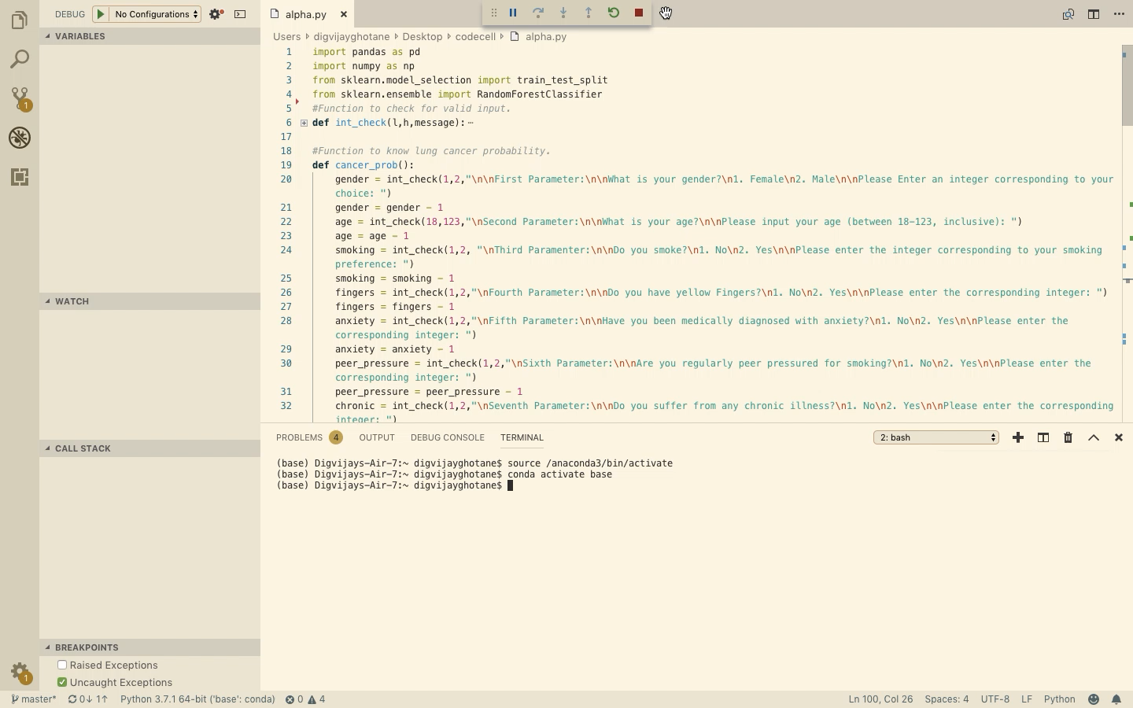
Healthy sixty year old man is susceptible to cancer as shown in the first video, but unhealthy sixty year old is more as shown in the second.

Slide 11
Fin.
Thank you!

